Slide 1
School of Computing Science and Engineering
Course Code: BCSE2350 Course Name: Cryptographic Fundamental
Web Security

Slide 2
Web Security
Web now widely used by business, government, individuals
but Internet & Web are vulnerable
have a variety of threats
integrity
confidentiality
denial of service
authentication
need added security mechanisms
Notes:
The World Wide Web is widely used by businesses, government agencies, and many individuals. But the Internet and the Web are extremely vulnerable to compromises of various sorts, with a range of threats as shown. These can be described as passive attacks including eavesdropping on network traffic between browser and server and gaining access to information on a Web site that is supposed to be restricted, and active attacks including impersonating another user, altering messages in transit between client and server, and altering information on a Web site. The web needs added security mechanisms to address these threats.

Slide 3
SSL (Secure Socket Layer)
transport layer security service
originally developed by Netscape
version 3 designed with public input
subsequently became Internet standard known as TLS (Transport Layer Security)
uses TCP to provide a reliable end-to-end service
SSL has two layers of protocols
Notes:
SSL probably most widely used Web security mechanism. Its implemented at the Transport layer; cf IPSec at Network layer; or various Application layer mechanisms eg. S/MIME & SET (later).
SSL is designed to make use of TCP to provide a reliable end-to-end secure service. Netscape originated SSL. Version 3 of the protocol was designed with public review and input from industry and was published as an Internet draft document. Subsequently, the IETF TLS working group was formed to develop a common standard. SSL is not a single protocol but rather two layers of protocol, as shown next.

Slide 4
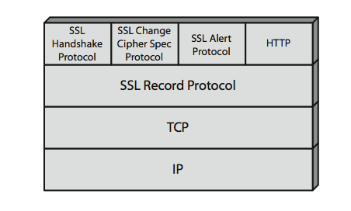
SSL Architecture
Notes:
Stallings Figure 17.2 shows the SSL Protocol stack. The SSL Record Protocol provides basic security services to various higher-layer protocols. In particular, the Hypertext Transfer Protocol (HTTP), which provides the transfer service for Web client/server interaction, can operate on top of SSL. Three higher-layer protocols are also defined as part of SSL: the Handshake Protocol, Change Cipher Spec Protocol, and Alert Protocol. These SSL-specific protocols are used in the management of SSL exchanges.

Slide 5
SSL Architecture
SSL connection
a transient, peer-to-peer, communications link
associated with 1 SSL session
SSL session
an association between client & server
created by the Handshake Protocol
define a set of cryptographic parameters
may be shared by multiple SSL connections
Notes:
Two important SSL concepts are the SSL connection and the SSL session:
• Connection: A connection is a network transport that provides a suitable type of service, such connections are transient, peer-to-peer relationships, associated with one session
• Session: An SSL session is an association between a client and a server, created by the Handshake Protocol. Sessions define a set of cryptographic security parameters, which can be shared among multiple connections. Sessions are used to avoid the expensive negotiation of new security parameters for each connection.

Slide 6
SSL Record Protocol Services
message integrity
using a MAC with shared secret key
similar to HMAC but with different padding
confidentiality
using symmetric encryption with a shared secret key defined by Handshake Protocol
AES, IDEA, RC2-40, DES-40, DES, 3DES, Fortezza, RC4-40, RC4-128
message is compressed before encryption
Notes:
SSL Record Protocol defines two services for SSL connections:
• Message Integrity: The Handshake Protocol also defines a shared secret key that is used to form a message authentication code (MAC), which is similar to HMAC
• Confidentiality: The Handshake Protocol defines a shared secret key that is used for conventional encryption of SSL payloads. The message is compressed before being concatenated with the MAC and encrypted, with a range of ciphers being supported as shown.

Slide 7
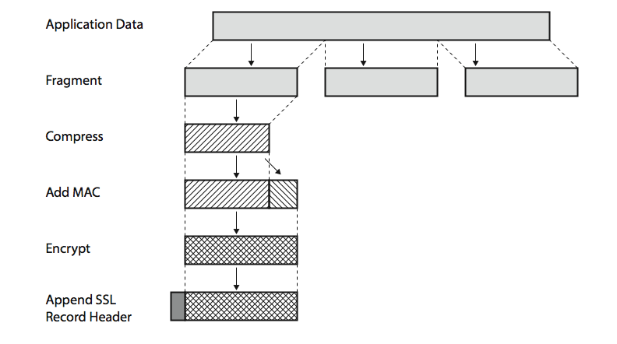
SSL Record Protocol Operation
Notes:
Stallings Figure17.3 shows the overall operation of the SSL Record Protocol. The Record Protocol takes an application message to be transmitted, fragments the data into manageable blocks, optionally compresses the data, applies a MAC, encrypts, adds a header, and transmits the resulting unit in a TCP segment. Received data are decrypted, verified, decompressed, and reassembled and then delivered to higher-layer applications.

Slide 8
SSL Change Cipher Spec Protocol
one of 3 SSL specific protocols which use the SSL Record protocol
a single message
causes pending state to become current
hence updating the cipher suite in use
Notes:
The Change Cipher Spec Protocol is one of the three SSL-specific protocols that use the SSL Record Protocol, and it is the simplest, consisting of a single message. Its purpose is to cause the pending state to be copied into the current state, which updates the cipher suite to be used on this connection.

Slide 9
SSL Alert Protocol
conveys SSL-related alerts to peer entity
severity
warning or fatal
specific alert
fatal: unexpected message, bad record mac, decompression failure, handshake failure, illegal parameter
warning: close notify, no certificate, bad certificate, unsupported certificate, certificate revoked, certificate expired, certificate unknown
compressed & encrypted like all SSL data
Notes:
The Alert Protocol is used to convey SSL-related alerts to the peer entity. As with other applications that use SSL, alert messages are compressed and encrypted, as specified by the current state.
Each message in this protocol consists of two bytes, the first takes the value warning(1) or fatal(2) to convey the severity of the message. The second byte contains a code that indicates the specific alert. The first group shown are the fatal alerts, the others are warnings.

Slide 10
SSL Handshake Protocol
allows server & client to:
authenticate each other
to negotiate encryption & MAC algorithms
to negotiate cryptographic keys to be used
comprises a series of messages in phases
Establish Security Capabilities
Server Authentication and Key Exchange
Client Authentication and Key Exchange
Finish
Notes:
The most complex part of SSL is the Handshake Protocol. This protocol allows the server and client to authenticate each other and to negotiate an encryption and MAC algorithm and cryptographic keys to be used to protect data sent in an SSL record. The Handshake Protocol is used before any application data is transmitted. The Handshake Protocol consists of a series of messages exchanged by client and server, which can be viewed in 4 phases:
Phase 1. Establish Security Capabilities - this phase is used by the client to initiate a logical connection and to establish the security capabilities that will be associated with it
Phase 2. Server Authentication and Key Exchange - the server begins this phase by sending its certificate if it needs to be authenticated.
Phase 3. Client Authentication and Key Exchange - the client should verify that the server provided a valid certificate if required and check that the server_hello parameters are acceptable
Phase 4. Finish - this phase completes the setting up of a secure connection. The client sends a change_cipher_spec message and copies the pending CipherSpec into the current CipherSpec

Slide 11
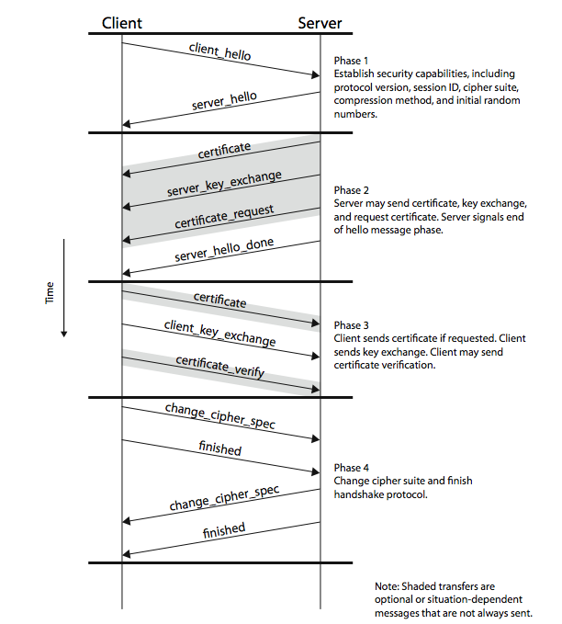
SSL Handshake Protocol
Notes:
Stallings Figure17.6 shows the initial exchange needed to establish a logical connection between client and server. The exchange can be viewed as having the four phases discussed previously.

Slide 12
TLS (Transport Layer Security)
IETF standard RFC 2246 similar to SSLv3
with minor differences
in record format version number
uses HMAC for MAC
a pseudo-random function expands secrets
has additional alert codes
some changes in supported ciphers
changes in certificate types & negotiations
changes in crypto computations & padding
Notes:
TLS is an IETF standardization initiative whose goal is to produce an Internet standard version of SSL. TLS is defined as a Proposed Internet Standard in RFC 2246. RFC 2246 is very similar to SSLv3, but with a number of minor differences in the areas shown, as discussed in the text.

Slide 13
Secure Electronic Transactions (SET)
open encryption & security specification
to protect Internet credit card transactions
developed in 1996 by Mastercard, Visa etc
not a payment system
rather a set of security protocols & formats
secure communications amongst parties
trust from use of X.509v3 certificates
privacy by restricted info to those who need it
Notes:
SET is an open encryption and security specification designed to protect credit card transactions on the Internet. SETv1 emerged from a call for security standards by MasterCard and Visa in 1996. Beginning in 1996, there have been numerous tests of the concept, and by 1998 the first wave of SET-compliant products was available. SET is not itself a payment system, rather it is a set of security protocols and formats that enables users to employ the existing credit card payment infrastructure on an open network, such as the Internet, in a secure fashion, by providing:
• a secure communications channel among all parties involved in a transaction
• trust through the use of X.509v3 digital certificates
• privacy because the information is only available to parties in a transaction when and where necessary.

Slide 14
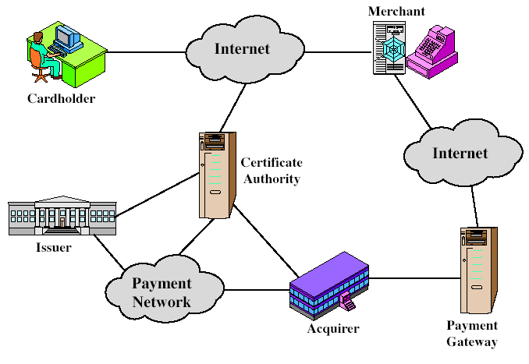
SET Components
Notes:
Stallings Figure17.8 indicates the participants in the SET system, being:
• Cardholder: purchasers interact with merchants from personal computers over the Internet
• Merchant: a person or organization that has goods or services to sell to the cardholder
• Issuer: a financial institution, such as a bank, that provides the cardholder with the payment card.
• Acquirer: a financial institution that establishes an account with a merchant and processes payment card authorizations and payments
• Payment gateway: a function operated by the acquirer or a designated third party that processes merchant payment messages
• Certification authority (CA): an entity that is trusted to issue X.509v3 public-key certificates for cardholders, merchants, and payment gateways

Slide 15
SET Transaction
customer opens account
customer receives a certificate
merchants have their own certificates
customer places an order
merchant is verified
order and payment are sent
merchant requests payment authorization
merchant confirms order
merchant provides goods or service
merchant requests payment
Notes:
Now briefly detail the sequence of events that are required for a transaction as shown, details in text.

Slide 16
Dual Signature
customer creates dual messages
order information (OI) for merchant
payment information (PI) for bank
neither party needs details of other
but must know they are linked
use a dual signature for this
signed concatenated hashes of OI & PI
DS=E(PR_{c}, [H(H(PI)||H(OI))])
Notes:
The purpose of the SET dual signature is to link two messages that are intended for two different recipients, the order information (OI) for the merchant and the payment information (PI) for the bank. The merchant does not need to know the customer’s credit card number, and the bank does not need to know the details of the customer’s order, however the two items must be linked in a way that can be used to resolve disputes if necessary. The customer takes the hash (using SHA-1) of the PI and the hash of the OI, concatenates them, and hashes the result. Finally,the customer encrypts the final hash with his or her private signature key, creating the dual signature. This can be summarized as: DS=E(PRc, [H(H(PI)||H(OI))])

Slide 17
SET Purchase Request
SET purchase request exchange consists of four messages
Initiate Request - get certificates
Initiate Response - signed response
Purchase Request - of OI & PI
Purchase Response - ack order
Notes:
The purchase request exchange consists of four messages: Initiate Request, Initiate Response, Purchase Request, and Purchase Response. In order to send SET messages to the merchant, the cardholder must have a copy of the certificates of the merchant and the payment gateway. The customer requests the certificates in the Initiate Request message, sent to the merchant. The merchant generates a response and signs it with its private signature key. The cardholder verifies the merchant and gateway certificates by means of their respective CA signatures and then creates the OI and PI. Next, the cardholder prepares the Purchase Request message with Purchase-related information & Order-related information. The Purchase Response message includes a response block that acknowledges the order and references the corresponding transaction number.

Slide 18
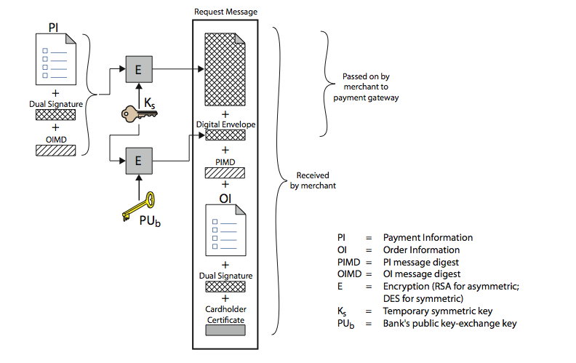
Purchase Request – Customer
Notes:
Stallings Figure 17.10 shows the details of the contents of the Purchase Request message generated b y the customer.
The message includes the following:
Purchase-related information, which will be forwarded to the payment gateway by the merchant and consists of: PI, dual signature, & OI message digest (OIMD).
2. Order-related information, needed by the merchant and consists of: OI, dual signature, PI message digest (PIMD).
3. Cardholder certificate. This contains the cardholder’s public signature key.

Slide 19
Purchase Request – Merchant
verifies cardholder certificates using CA sigs
verifies dual signature using customer's public signature key to ensure order has not been tampered with in transit & that it was signed using cardholder's private signature key
processes order and forwards the payment information to the payment gateway for authorization (described later)
sends a purchase response to cardholder
Notes:
When the merchant receives the Purchase Request message, the actions listed are performed.
Details of the request verification are shown on the next slide; and of the payment authorization on the following slide.
The Purchase Response message includes a response block that acknowledges the order and references the corresponding transaction number. This block is signed by the merchant using its private signature key.The block and its signature are sent to the customer, along with the merchant’s signature certificate.

Slide 20
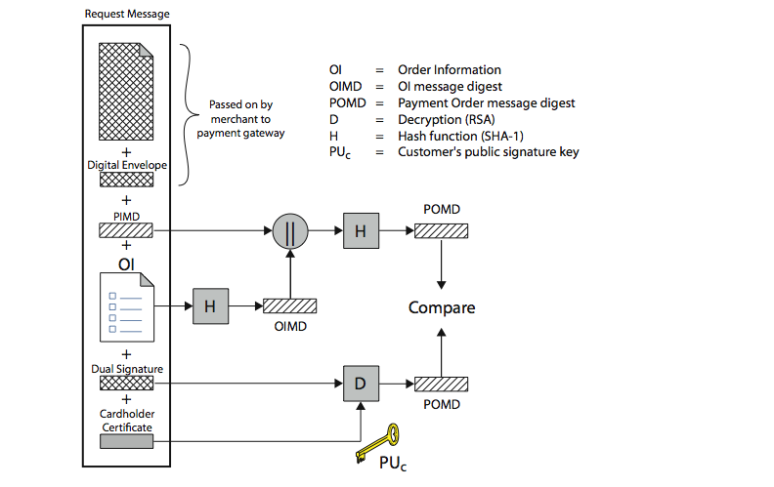
Purchase Request – Merchant
Notes:
Stallings Fig 17.11 illustrates the crypto processes used by the merchant to verify the customer’s purchase request order (step 2 on previous slide).

Slide 21
Payment Gateway Authorization
verifies all certificates
decrypts digital envelope of authorization block to obtain symmetric key & then decrypts authorization block
verifies merchant's signature on authorization block
decrypts digital envelope of payment block to obtain symmetric key & then decrypts payment block
verifies dual signature on payment block
verifies that transaction ID received from merchant matches that in PI received (indirectly) from customer
requests & receives an authorization from issuer
sends authorization response back to merchant
Notes:
During the processing of an order from a cardholder, the merchant authorizes the transaction with the payment gateway (step 3 in merchants list previously).
The payment authorization ensures that the transaction was approved by the issuer, guarantees the merchant will receive payment, so merchant can provide services or goods to customer.
The payment authorization exchange consists of two messages: Authorization Request and Authorization response.
The payment gateway performs the tasks shown on receiving the Authorization Request message.

Slide 22
Payment Capture
merchant sends payment gateway a payment capture request
gateway checks request
then causes funds to be transferred to merchants account
notifies merchant using capture response
Notes:
To obtain payment, the merchant sends a capture request message to the payment gateway, for which the merchant generates, signs, and encrypts
a capture request block, including payment amount and transaction ID.
The payment gateway receives the capture request message, decrypts and verifies the capture request block and decrypts and verifies the capture token block. It then checks for consistency between the capture request and capture token.
It then creates a clearing request sent to the issuer over the private payment network, which causes funds to be transferred to the merchant’s account.
The gateway then notifies the merchant of payment in a Capture Response message, which includes a capture response block that the gateway signs
and encrypts, plus the gateway’s signature key certificate. The merchant software stores the capture response to be used for reconciliation with payment received from the acquirer.

Slide 23
Summary
have considered:
need for web security
SSL/TLS transport layer security protocols
SET secure credit card payment protocols
Notes:
Chapter 17 summary.

